Slide 1
Probability
EQ – How do I calculate probabilities of combined events using two-way tables?

Slide 2
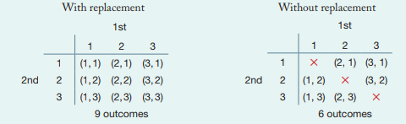
Give students post it notes and get them to label them 1, 2 and 3. Get students to do these 2 versions
You have 3 sets of cards labelled: 1, 2 and 3. Two selections are made each time.
Here are the two-way tables showing the outcomes when the card is replaced each time versus when there is no replacement

Slide 3
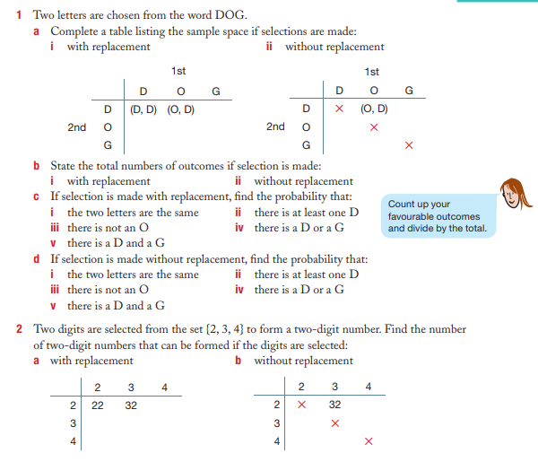
Your turn: Complete this in your Interactive notebook
Using two-way tables to calculate probabilities in situations that involves replacement and no replacement

Slide 4
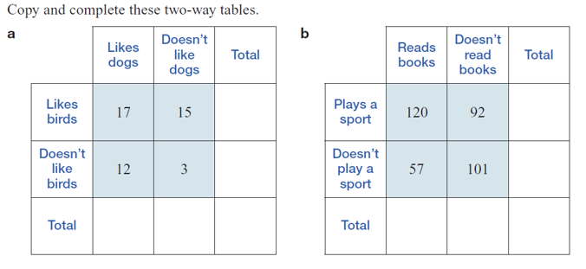
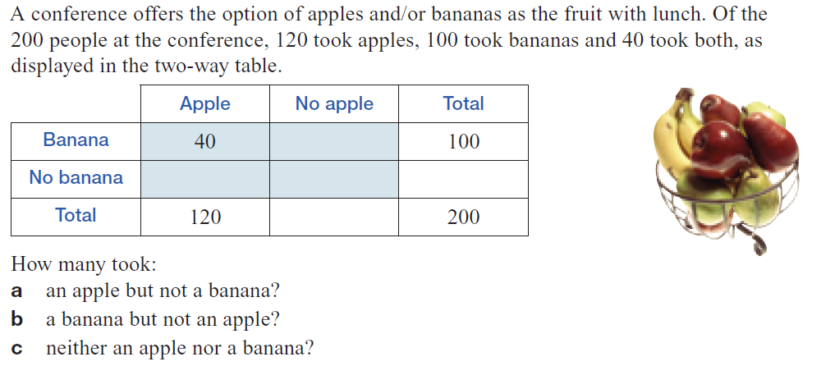
Your turn: Complete this in your Interactive notebook
Using two-way tables to calculate probabilities
3.
4.
Notes:
Guided practice

Slide 5
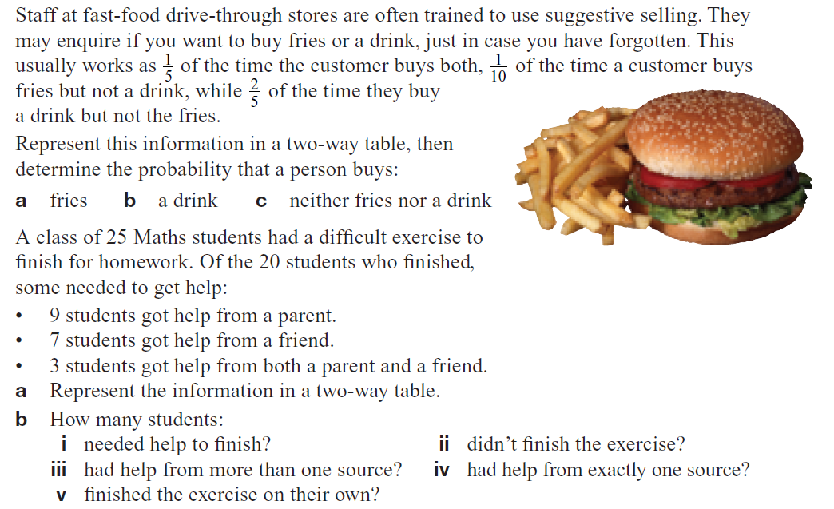
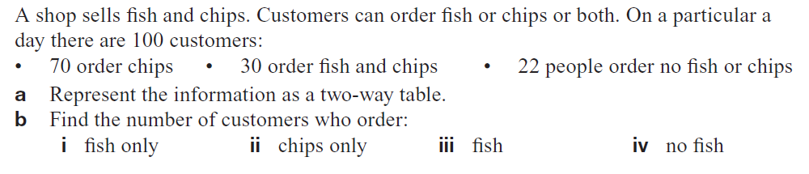
5.
6.
7.

